Slide 1
Progress Project
Sabtu, 7 maret 2015
Jam 18.26

Slide 2
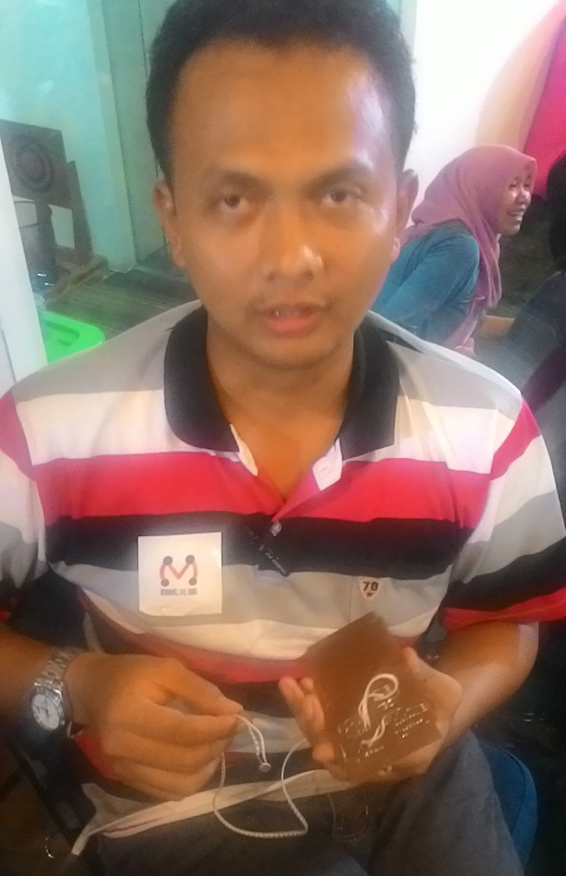
Hendro Soemarno Hardware Enginer

Slide 3
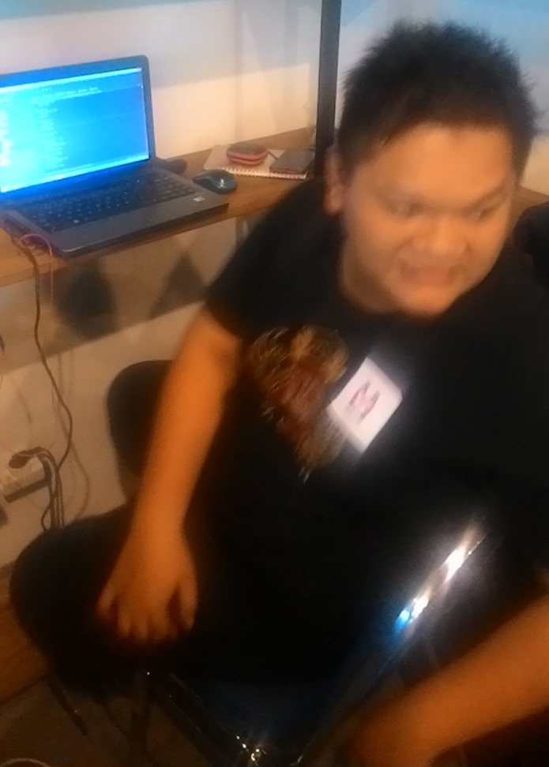
Yaniko Server And Web Apps Engineer

Slide 4
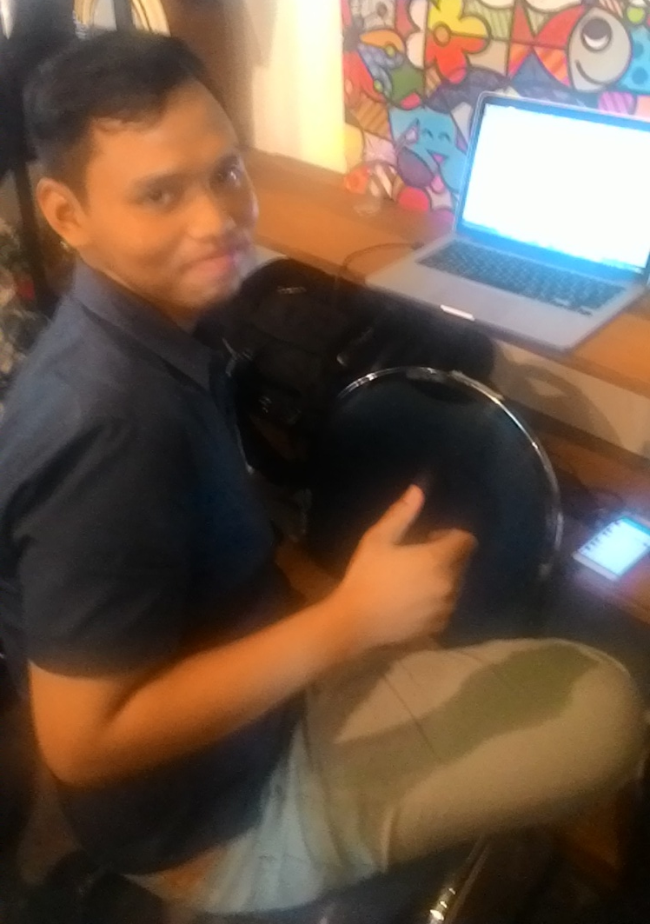
Danang Android Developer

Slide 5
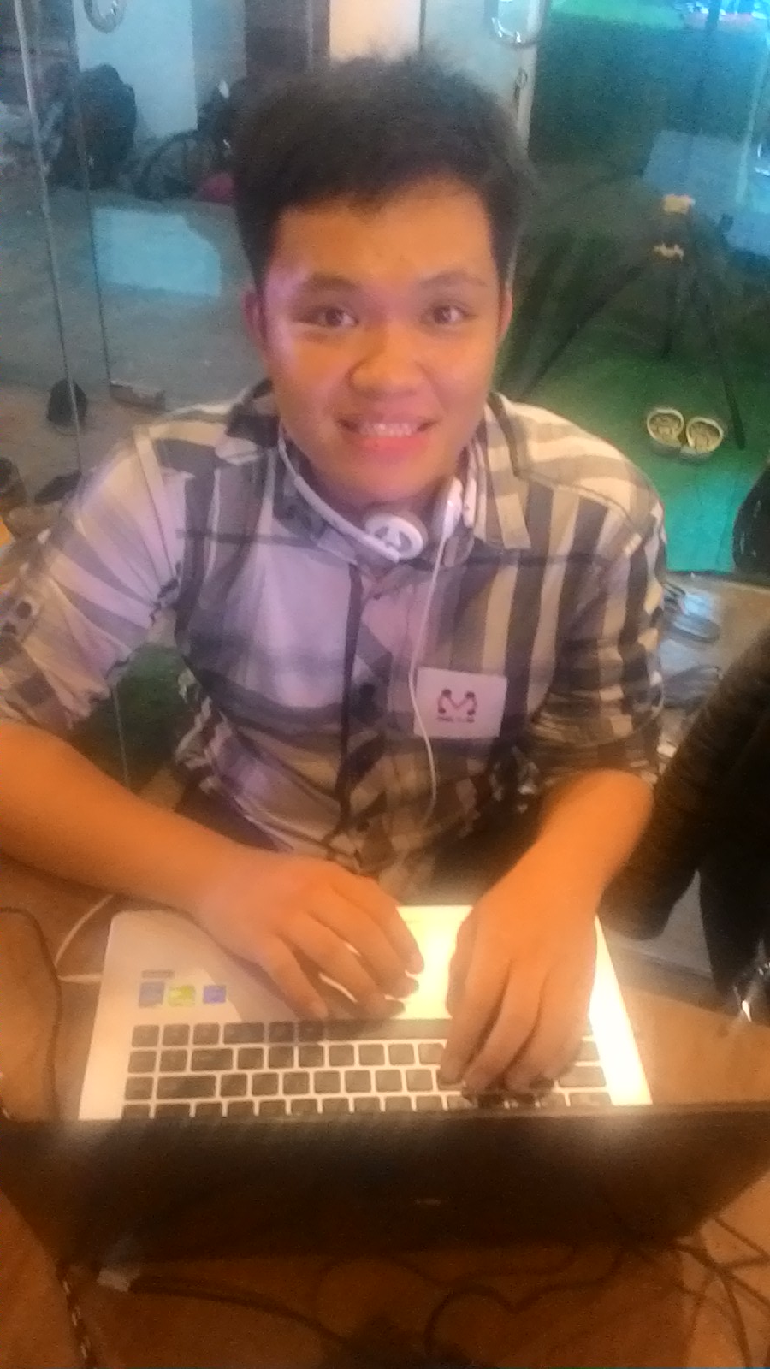
Edo Web App Enginer

Slide 6
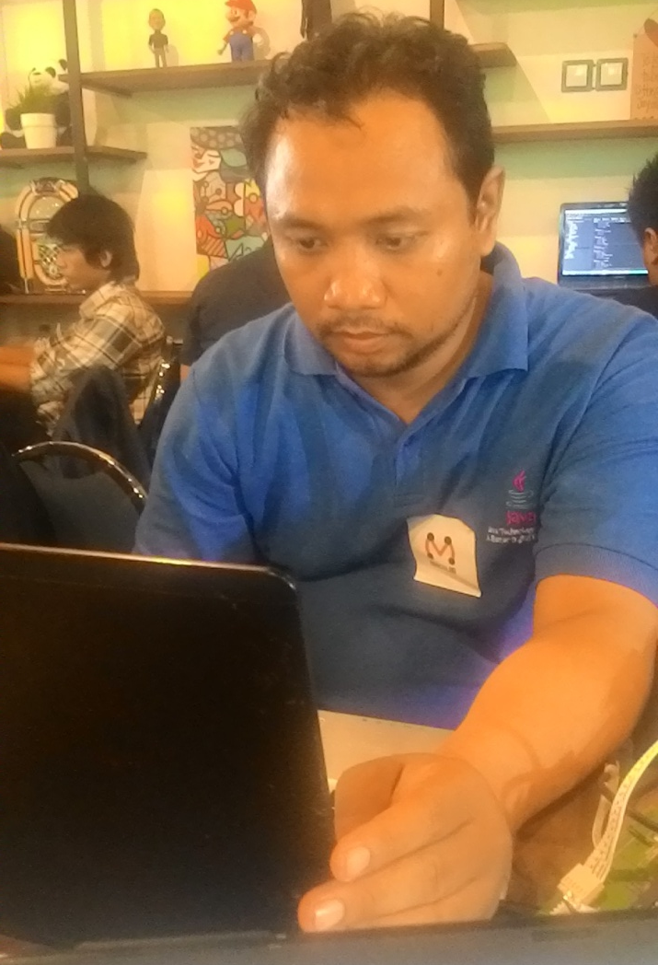
Zaenal Arifin Business and System Analyst

Slide 7
Progress Report I
Sabtu 7 Maret 2015, Jam 18.30
OverAll Progress 30%
Hardware : 2 Sensor Deteksi Parkir dan Request 3D untuk Lahan Parkir – Box Sensor
Login Android Apps
Web Apps Parking System UI Desain

Slide 8
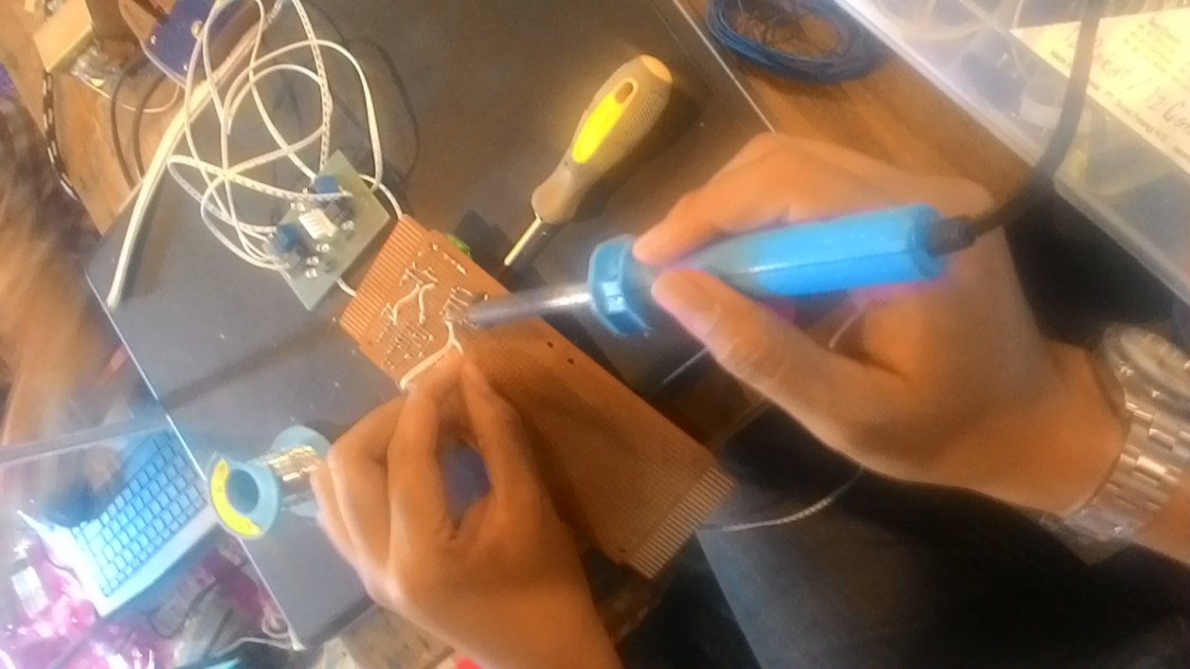
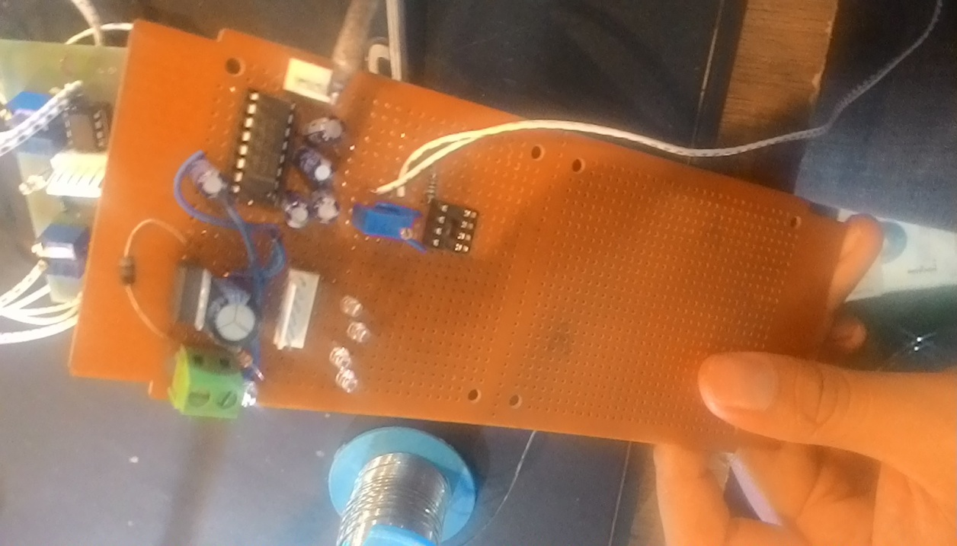
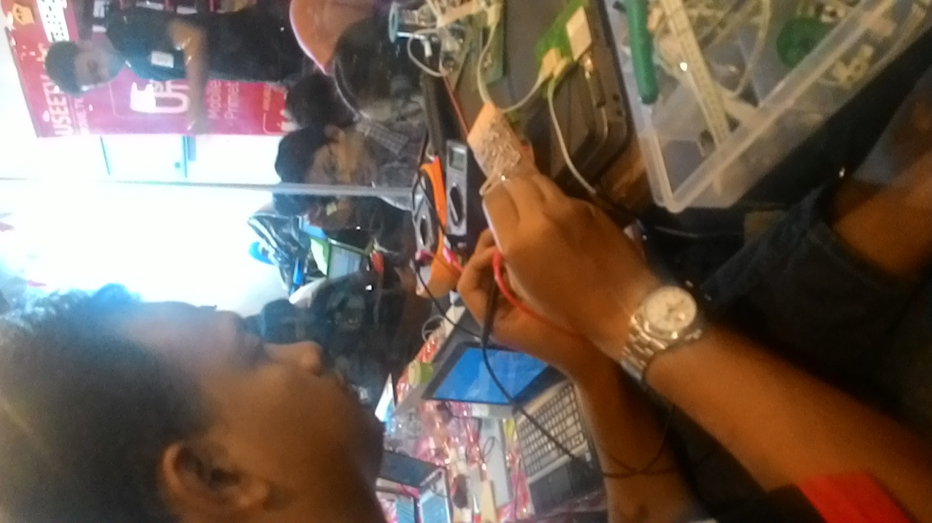
Hardware Progress 2 Sensor Untuk Parkiran

Slide 9
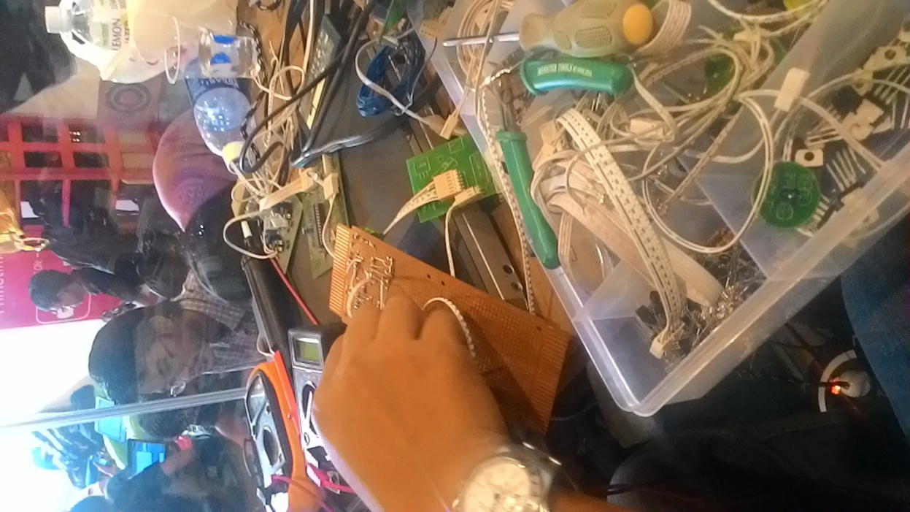
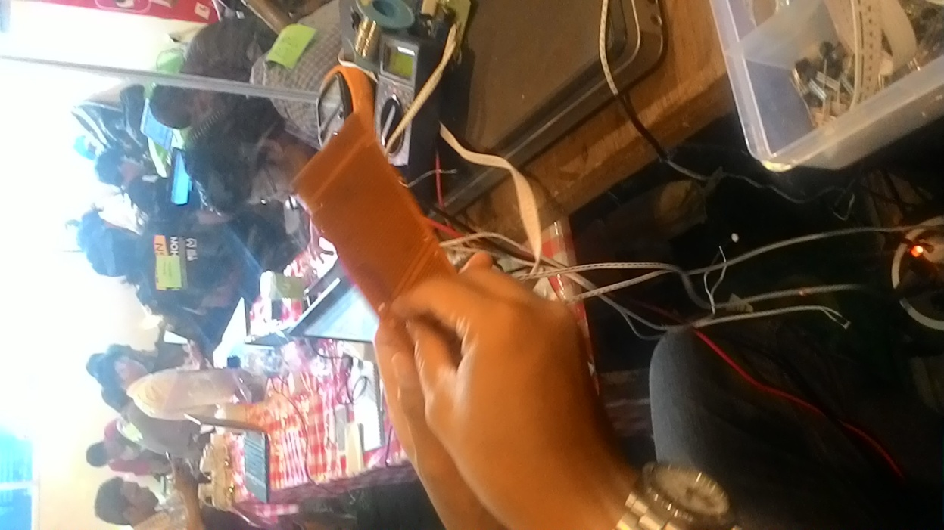
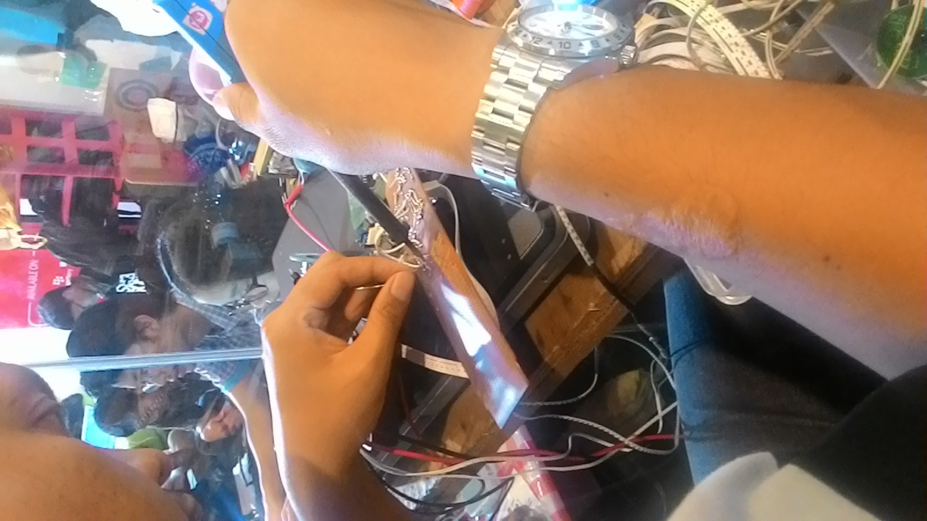

Slide 10
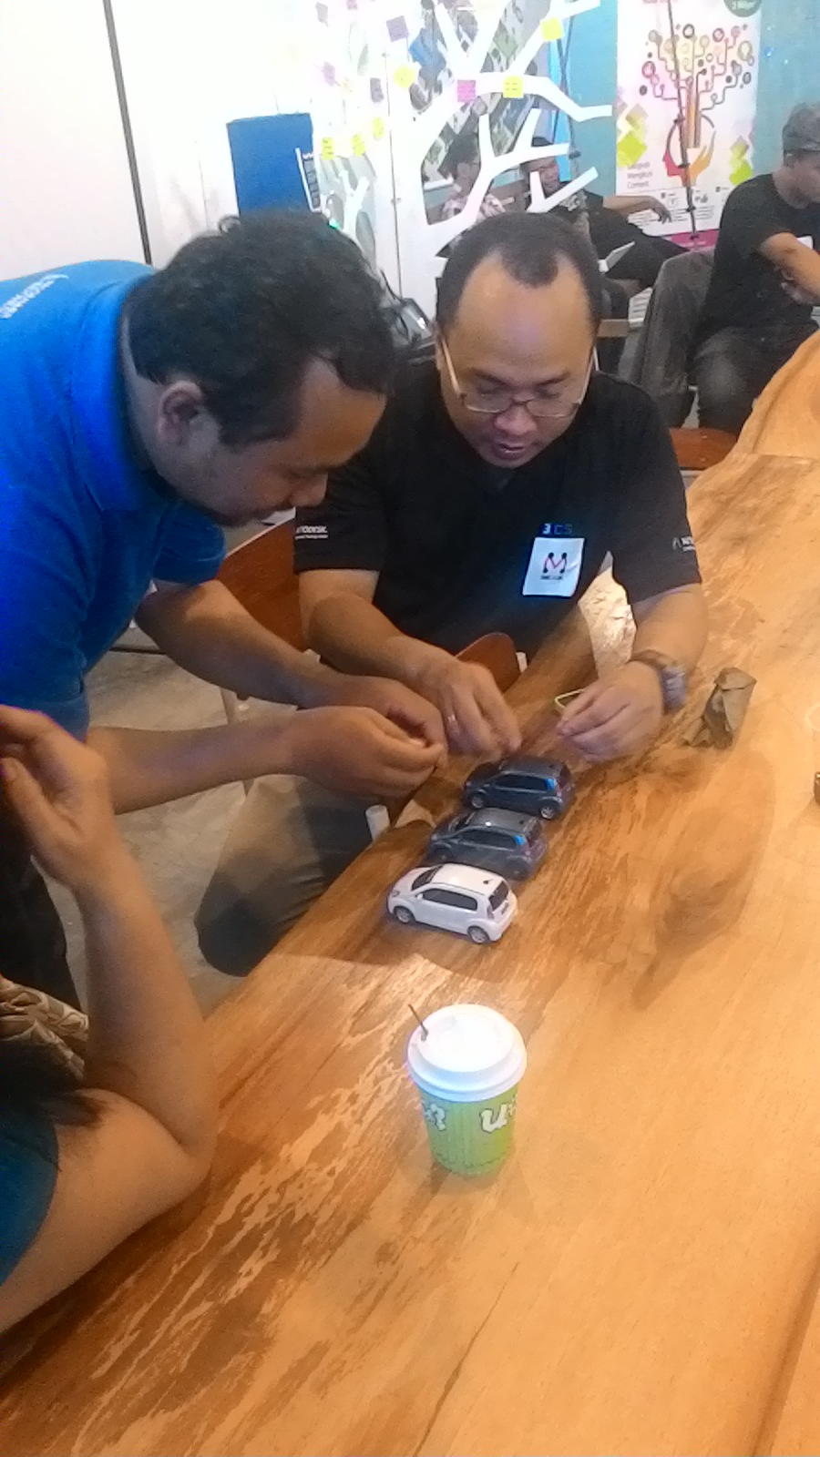
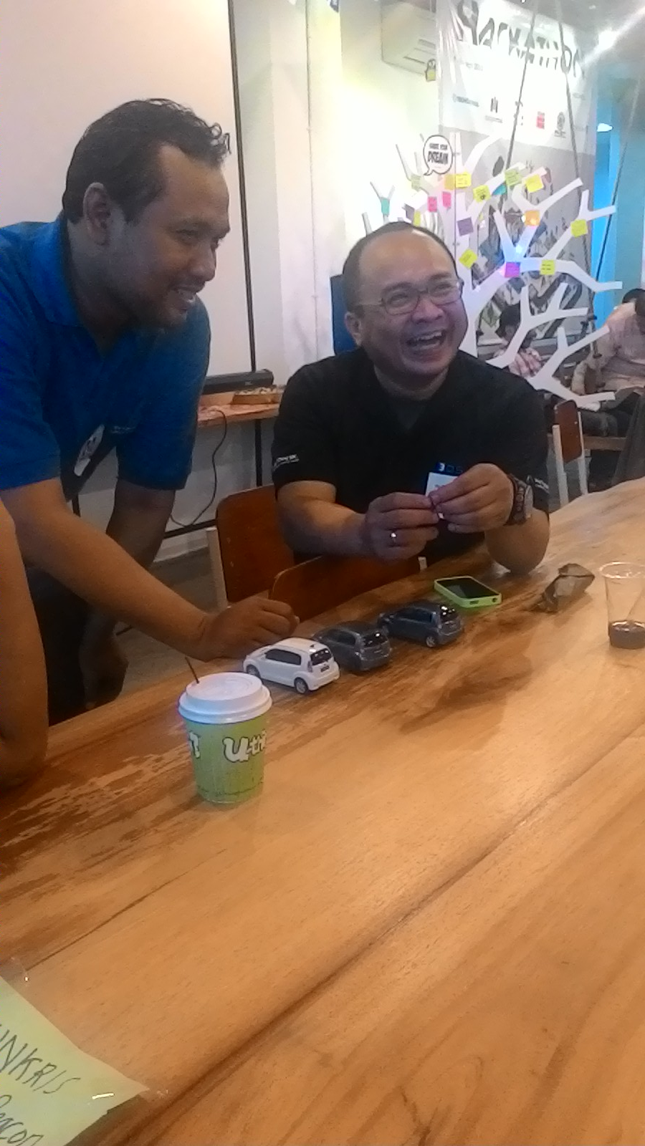
Konsultasi Desain Parkir 3D

Slide 11
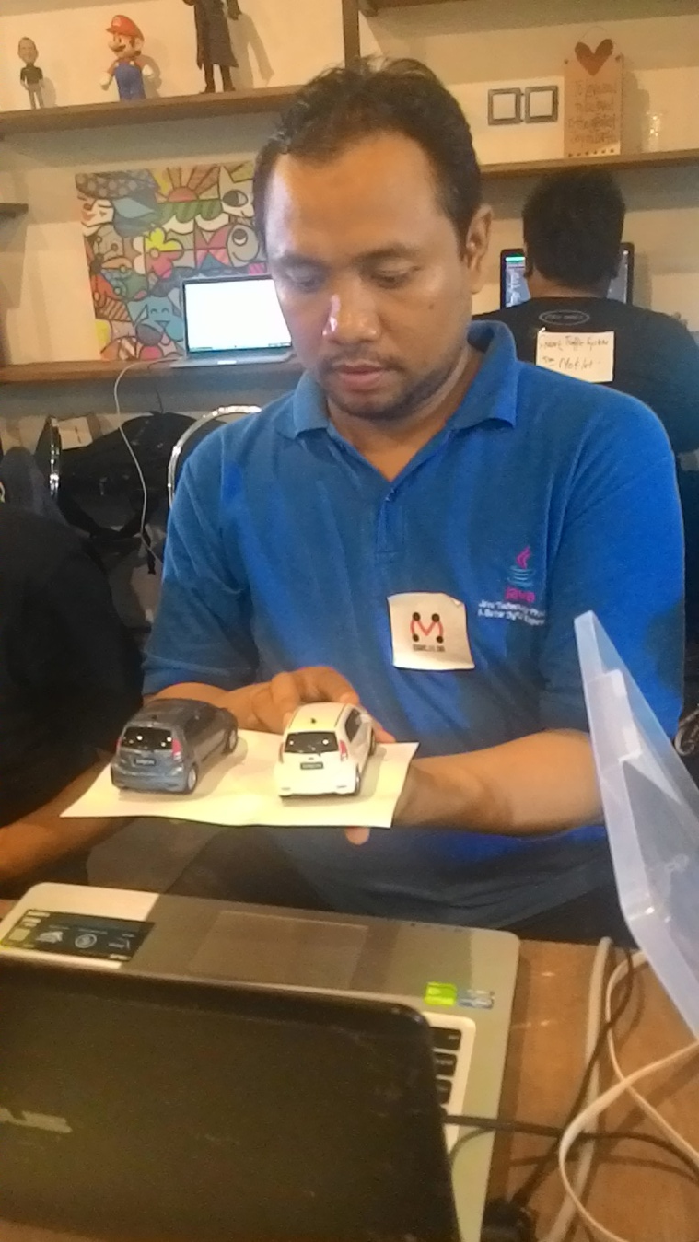

Slide 12
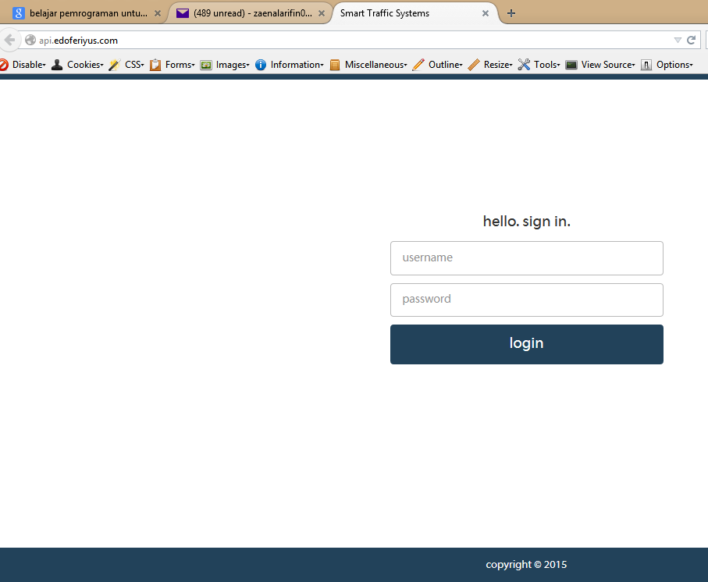
Progress Web Apps

Slide 13
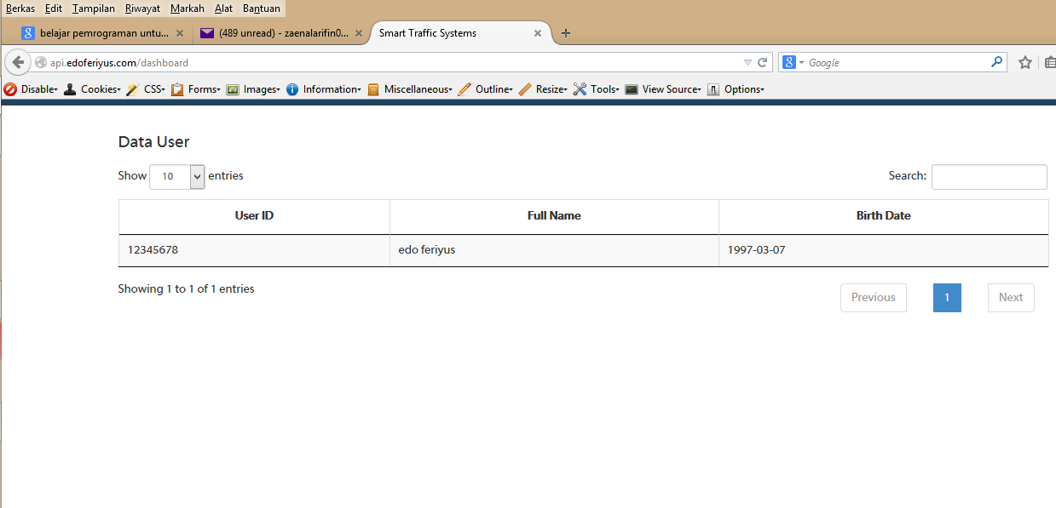
Page User Register

Slide 14
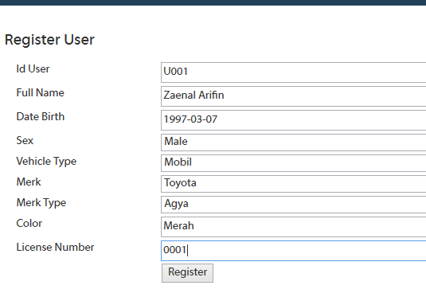

Slide 15
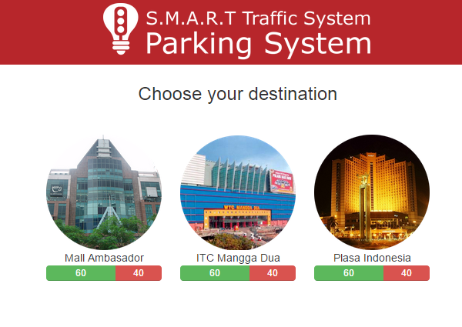
Desain UI Web App Parking System

Slide 16
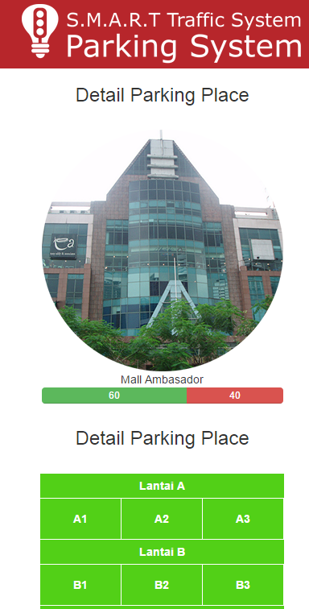
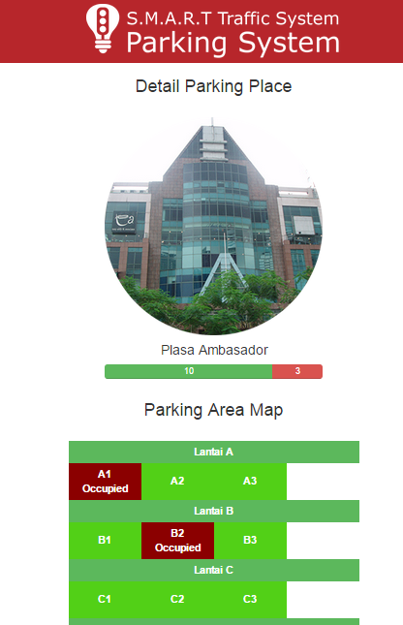

Slide 17
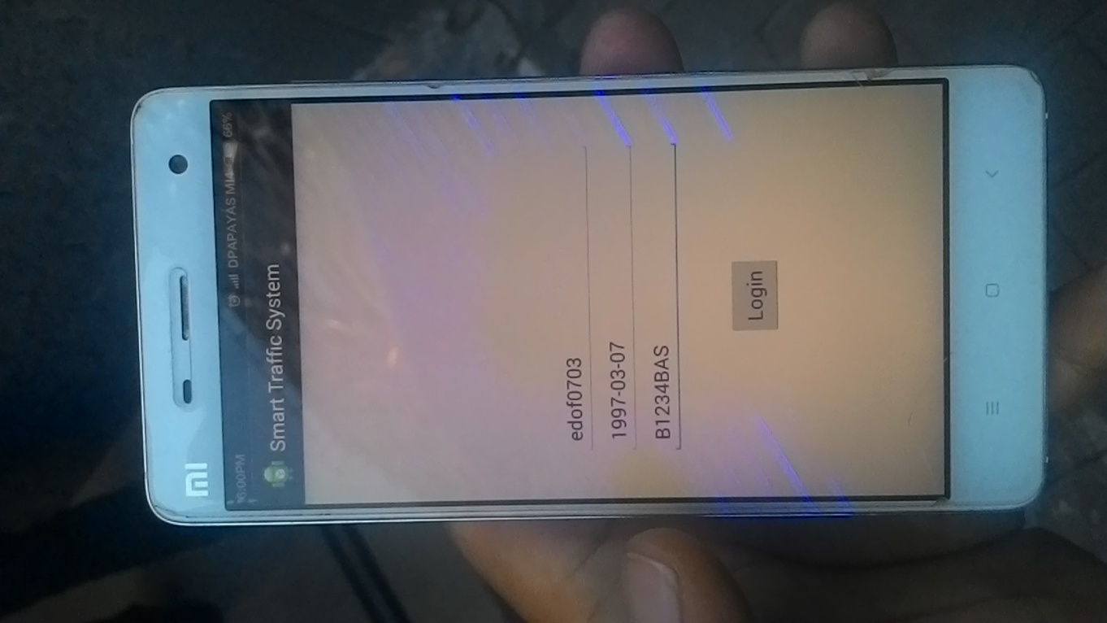
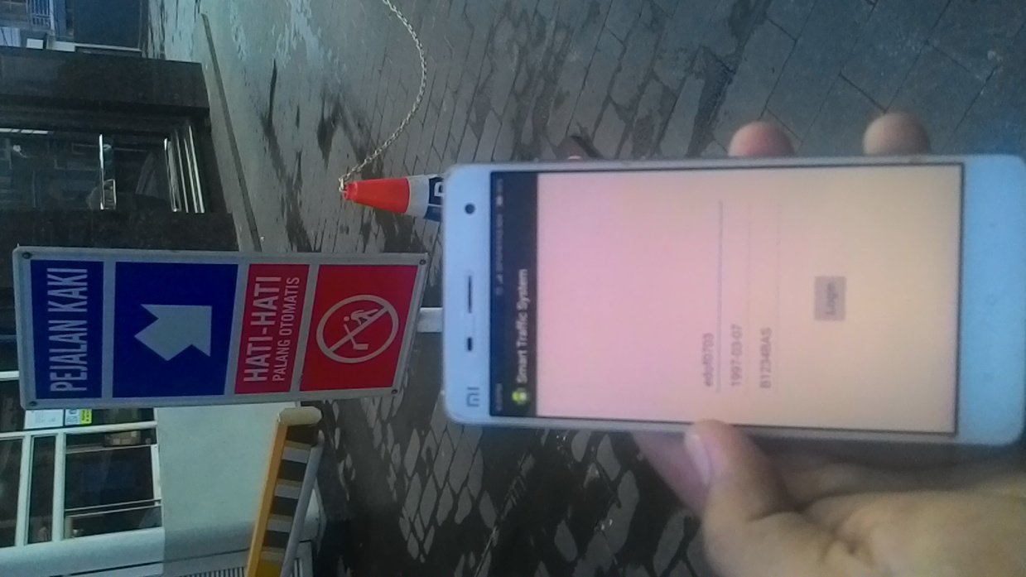
Android Apps

Slide 18
Progress Report II
8 Maret 2015 Jam 07.00
OverAll Progress 75%
Hardware : 4 Sensor Deteksi Parkir dan Testing
Request 3D untuk Lahan Parkir – Box Sensor
Login Android Apps
Web Apps Parking System Integration with Sensor Parking System

Slide 19
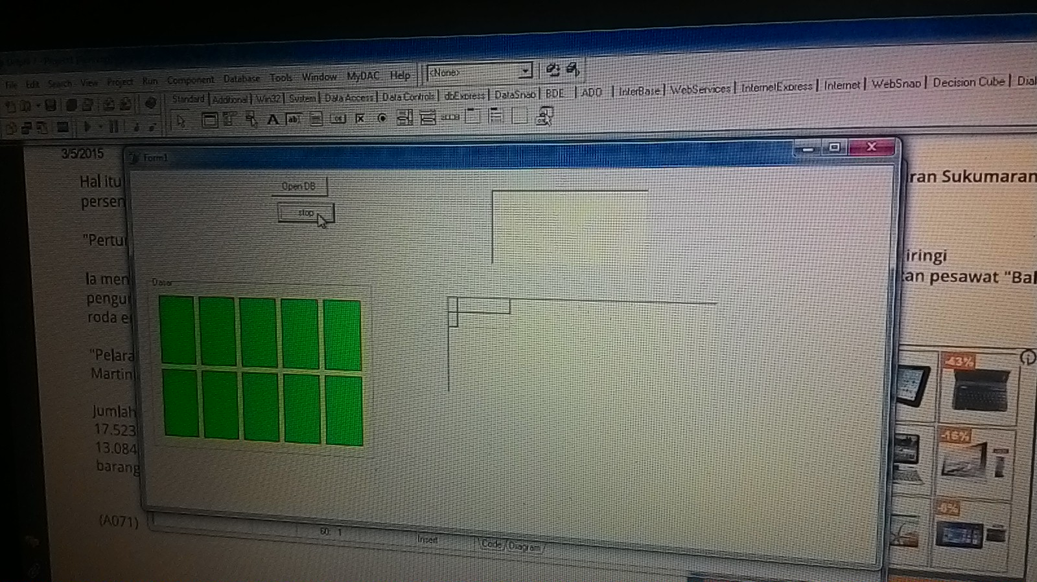
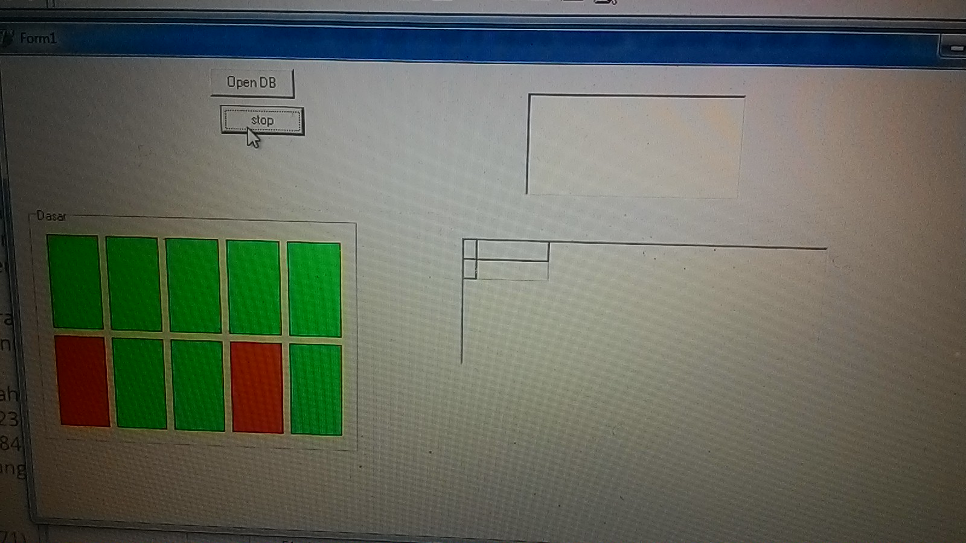
Testing Sensor

Slide 20
Sensor Send To Server

Slide 21
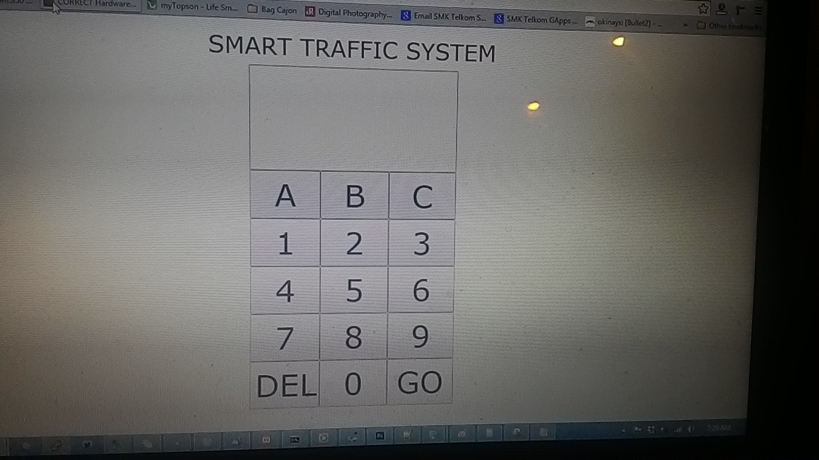
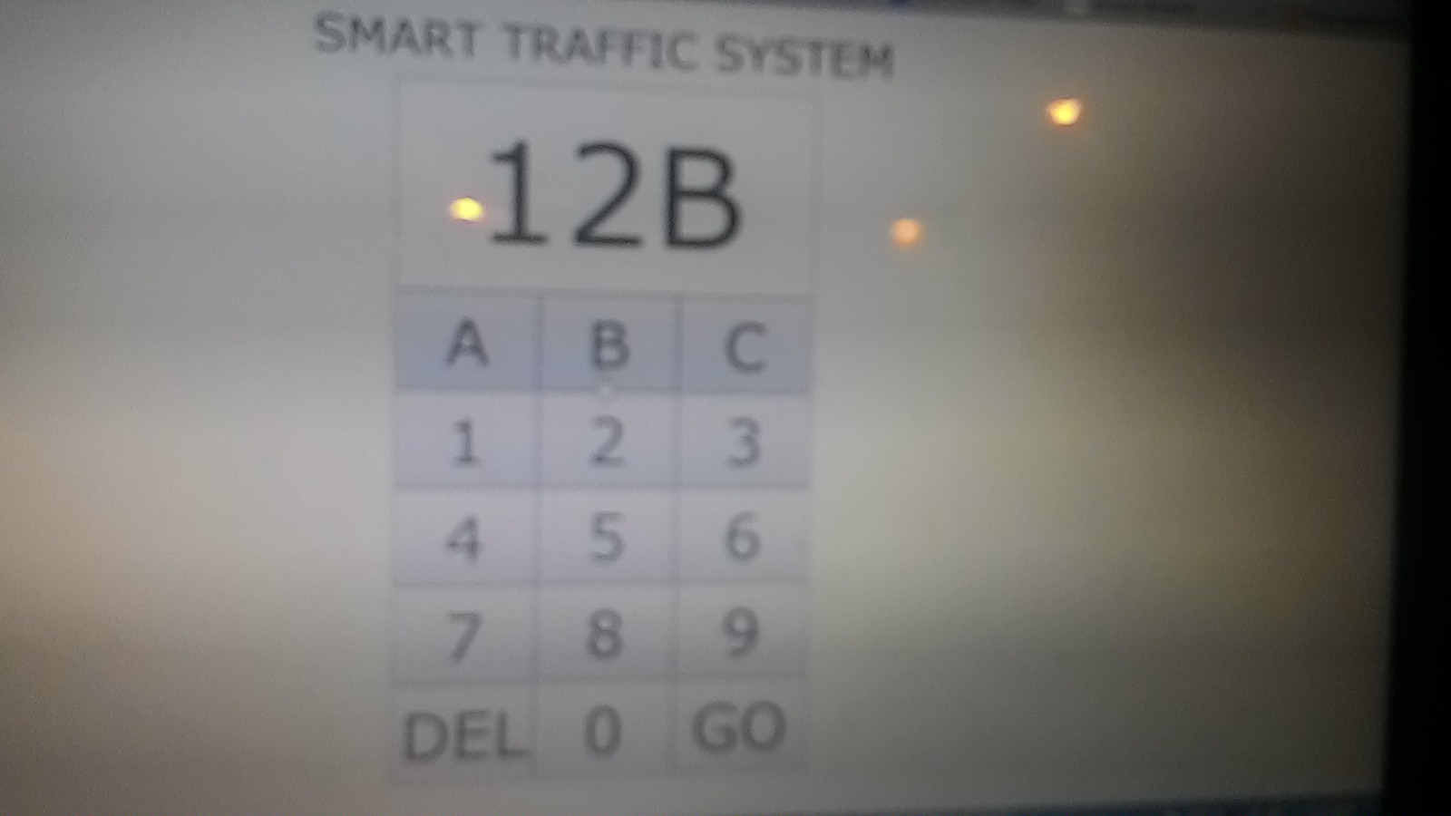
Interface Pin Parking

Slide 22
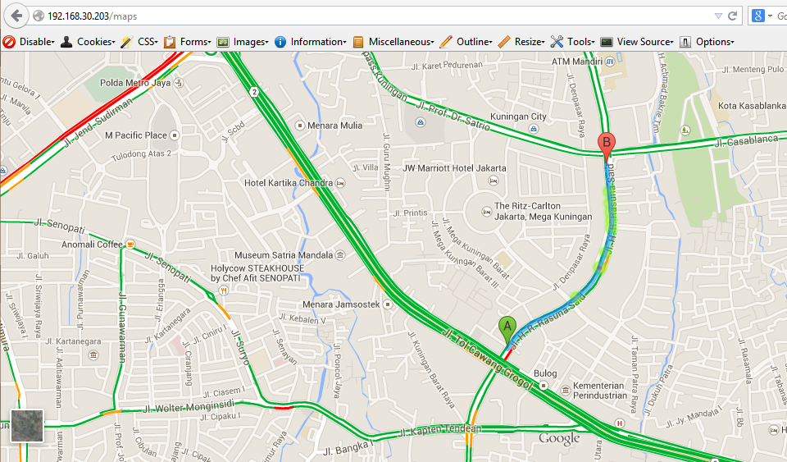
Maps – Nearby - POI

